Slide 1
Project - Movie Data Analytics and dashboard
deployment
Name - Ali Haroon Mehmood
Course - Introductory Data Analytics (From OneLearn)

Slide 2
Business Problem :Mubi.com is an online movie platform which tries to show movies most preferred by audience.It earns profits through number of people using their platform and therefore wants to include such movies so that maximum people use it.
For this purpose Mubi.com wants to analyse audience movie preference and the earning potential of movies so as to maximise its users.We as data analyst,will use process of analytics life cycle to solve this problem.
We are given this problem statement from the business side-
“Analysing audience movie preference and earning potential of movies”

Slide 3
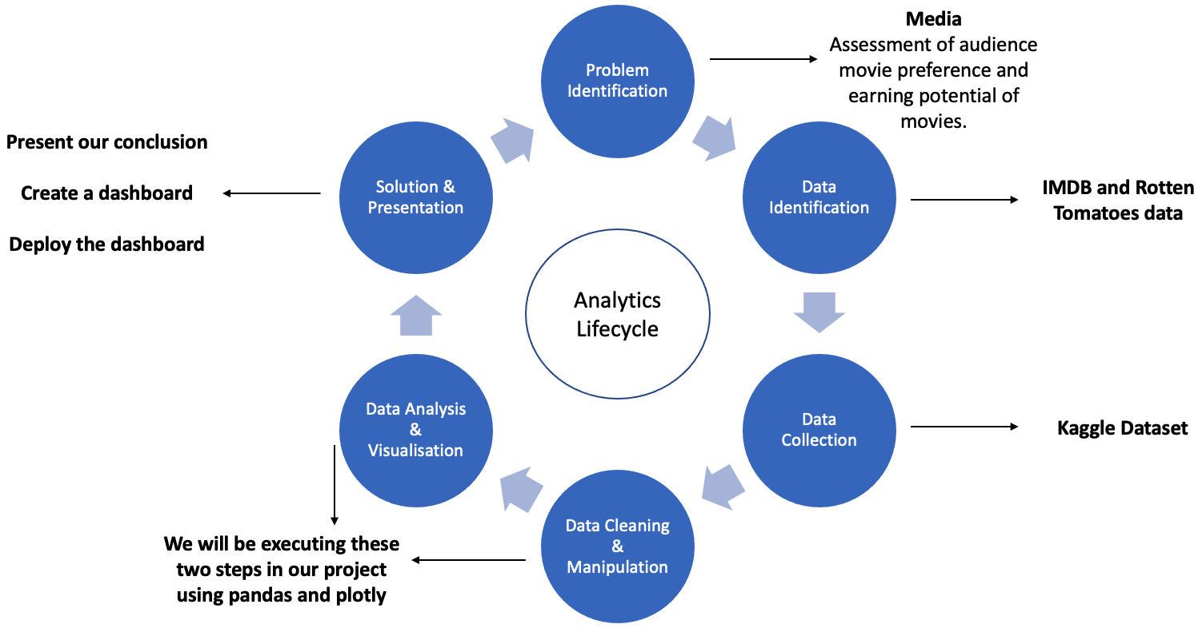

Slide 4
STEP 1: Problem Identification
We are given this problem statement from the business side-
“Analysing audience movie preference and earning potential of movies”
They need to have a solution to this project as it will help in understanding what movies should be marketed to their audience for increasing their earnings.
The analytics team in the company has come up with the following initial problem statement based on above requirements -
Analyse audience movie preference across different dimensions like rating system, genre, language etc.
Analyse movie earning based on audience movie preference and other dimensions like genre, year released etc.
Build an interactive dashboard based on above analysis so that business stakeholder can interact with data on their own and take quick decisions or do further research using this preliminary analysis.

Slide 5
STEP 2: Data Identification
We will choose the imdb and rotten dataset, below we are stating the reason why we are going with this data.
Ratings Data
The purpose of choosing imdb and rotten tomatoes rating was that these are the two most popular rating systems that people use to watch movies. So they can be taken as indicators for audience movie preference.
In particular
imdb score shows what a general moviegoer audience prefer
rotten tomatoes score shows how much critics prefer a movie
Earnings Data
Movie earnings data is available in the worldwide_gross_income column of IMDB dataset. It basically tells us the box office earnings of movies in millions.

Slide 6
STEP 3: Data Collection
We have collected our data from Kaggle for this problem because this is the easiest to get good quality data for our initial problem statement. By good quality we mean, a decent sized data representing the whole problem area.

Slide 7
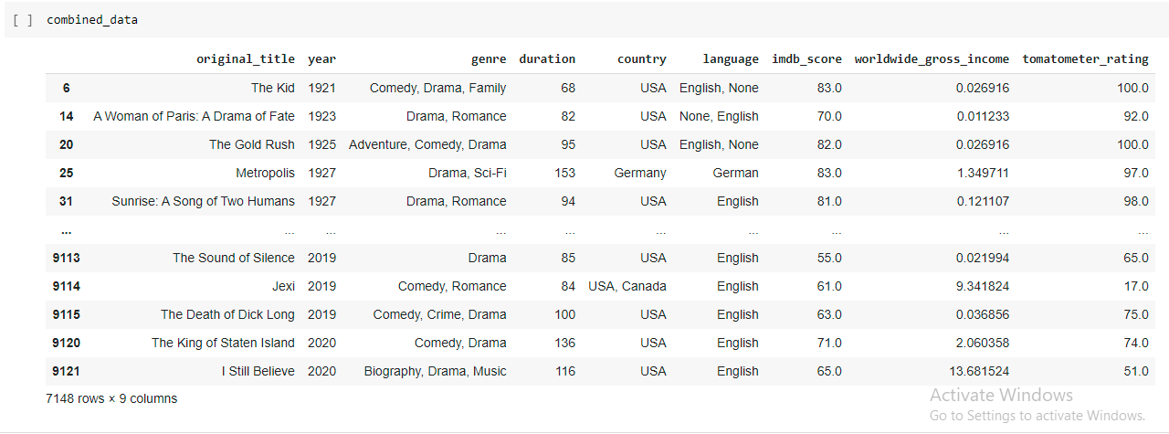
Slide 6 - Data Cleaning and Manipulation
We performed a series of cleaning and manipulation steps to create a final dataset for
further analysis.

Slide 8
STEP 5: Data Analysis and Visualisation
This step is all about solving for the 3 initial problems that the Analytics team identified ,with the Final dataset we have created.
The problems are-
Analyse audience movie preference across different dimensions like rating system, genre, language etc.
Analyse movie earning based on audience movie preference and other dimensions like genre, year released etc.
Build an interactive dashboard based on above analysis so that business stakeholder can interact with data on their own and take quick decisions or do further research using this preliminary analysis.

Slide 9
Assessment of Audience movie preference
We can analyse the two ratings of IMDB and rotten tomatoes across multiple dimensions to assess audience movie preference.
1.Rating preference across genre - which genres are more preferable.
2.Rating preference across year released - are old movies liked more or newer movies are liked more.

Slide 10
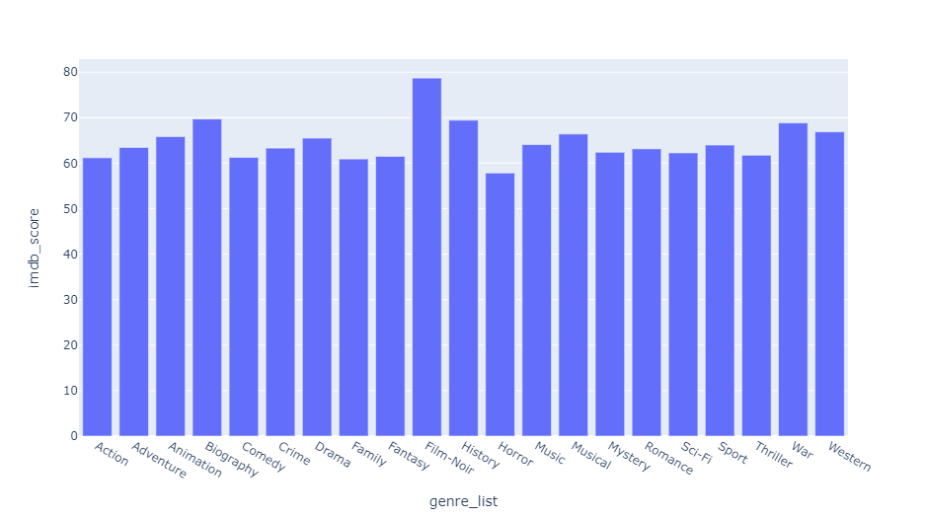
Rating preference across genre with respect to imdb score

Slide 11
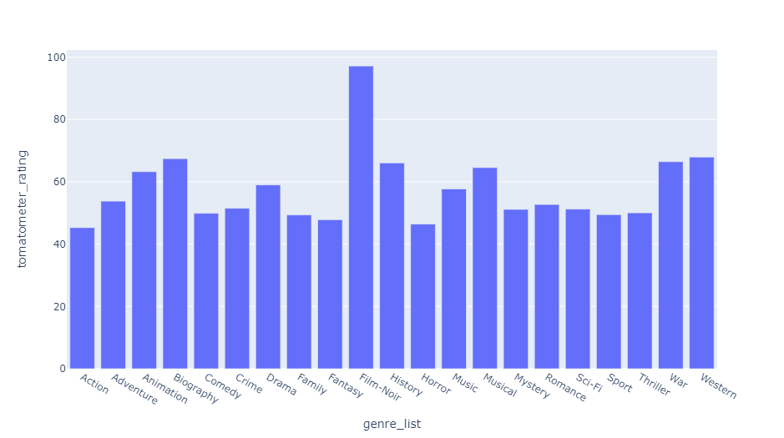
Rating preference across genre with respect tomatometer ratings

Slide 12
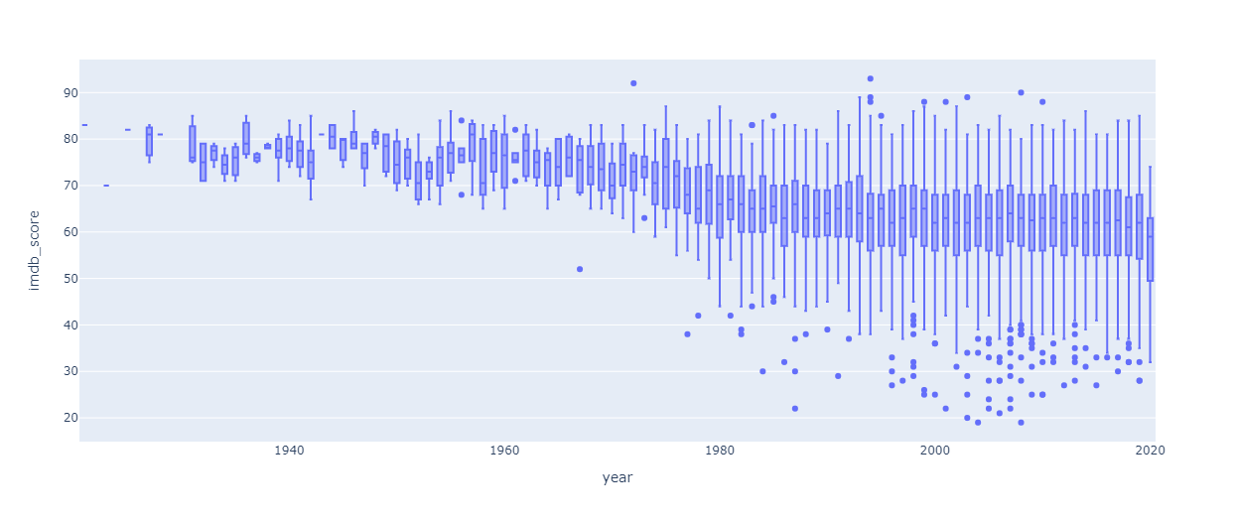
Rating preference across year released with respect to imdb score

Slide 13
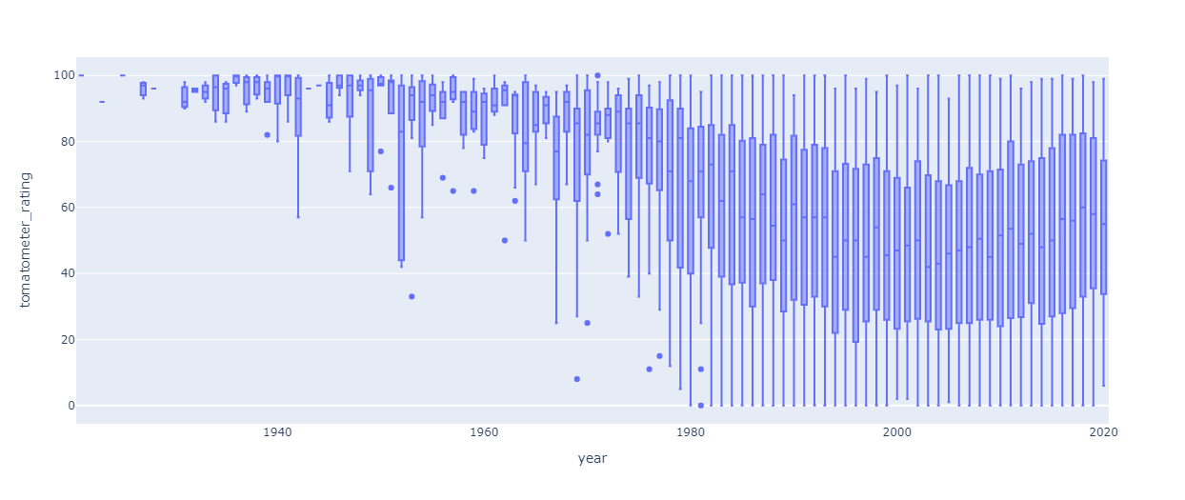
Rating preference across year released with respect to tomatometer ratings

Slide 14
Assessment of the movie earning potential
Using worldwide_gross_income column data we will analyse following points-
Earning potential and Genre Comparison - does genre affect the earning of a movie
Earning potential and country Comparison - does the earning of a movie differ based on the country it is getting released into.

Slide 15
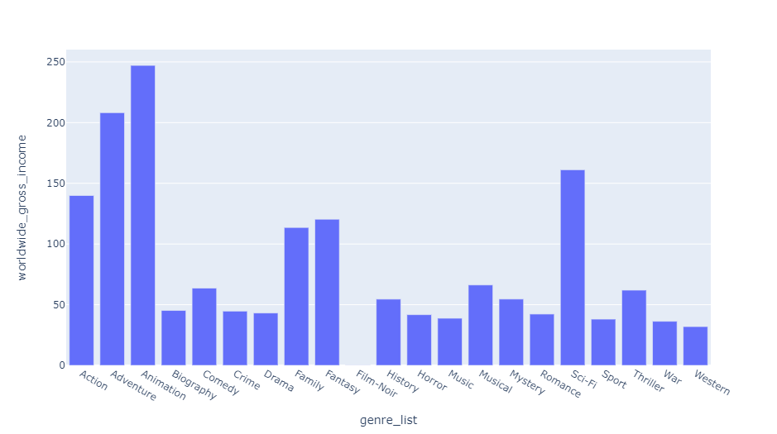
Earning potential and genre comparison.

Slide 16
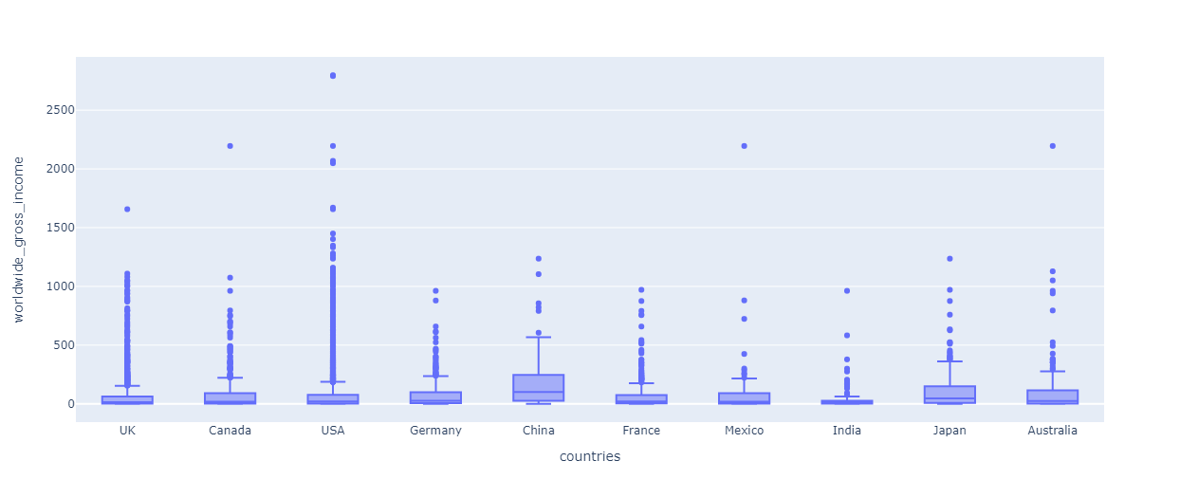
Earning potential and country analysis .

Slide 17
STEP 6: Solution and Presentation:For this step we have made a dashboard showing imdb and tomatometer ratings based on income,year and genres, link for the dashboard is shared below:
https://ali-dhttps://ali-dashboard-movies.herokuapp.com/ashboard-movies.herokuapp.com/
https://ali-dashboard-movies.herokuapp.com

